Slide 1

Independent Study Update: MMTN Week 1
Karthik 2021.10.22
AMLL

Slide 2
Overview
Goal 1: understand manifold learned by tandem model
Goal 2: mixture manifold tandem network

Slide 3
Tandem Model Recap
Forward model (g -> s)
2 inputs, 4 layers of 500 nodes, 1 output
Backward model (s -> g)
1 inputs, 4 layers of 500 nodes, 2 outputs
500 epochs, other hyperparameters from NA paper
Backward model: average of 0.028 eval error
Average of 0.025 inference error
Comparable to paper’s results; Ben has confirmed that baseline code is accurate

Slide 4
Goal 1: Understand manifold learned by tandem model
Input 500 uniformly connected outputs into backwards model from [-1, 1]
Outputs are the predicted 2-D x values, plotted on the right
As expected, connected spectra correspond to continuous set of geometries

Slide 5
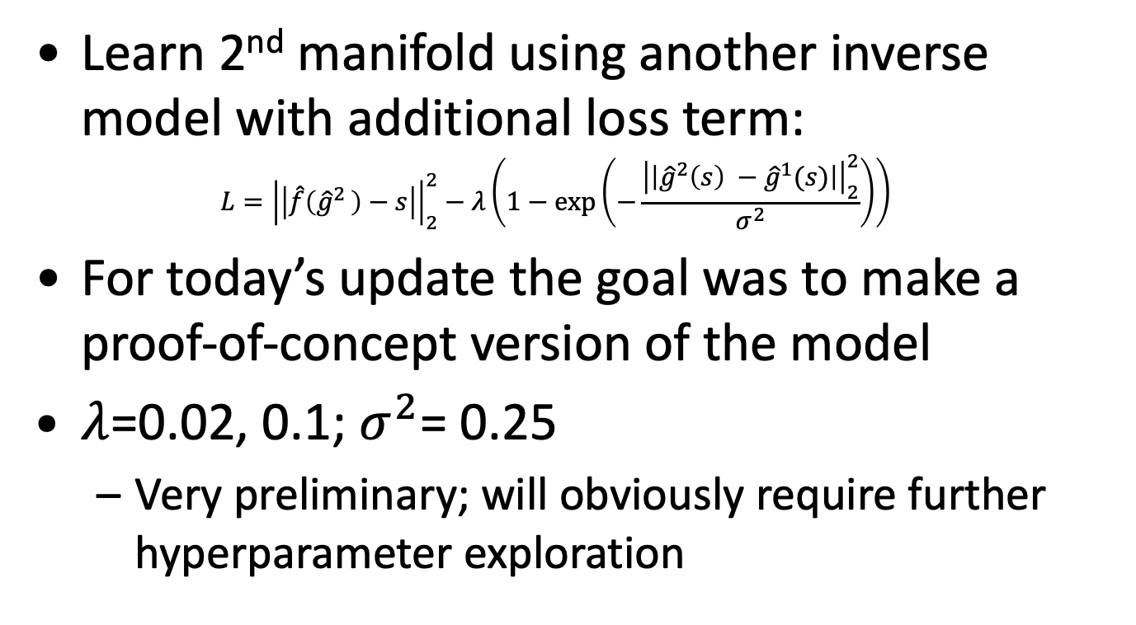
Goal 2: Mixture Model Tandem Network
Learn 2nd manifold using another inverse model with additional loss term: $L={\left|\left|\hat{f}\left({\hat{g}}^{2 }\right)−s\right|\right|}_{2}^{2}−λ\left(1−\exp\left(−\frac{{\left|\left|{\hat{g}}^{2}\left(s\right) −{\hat{g}}^{1}(s)\right|\right|}_{2}^{2}}{σ^{2}}\right)\right)$
For today’s update the goal was to make a proof-of-concept version of the model
$λ$=0.02, 0.1; $σ^{2}$= 0.25
Very preliminary; will obviously require further hyperparameter exploration

Slide 6
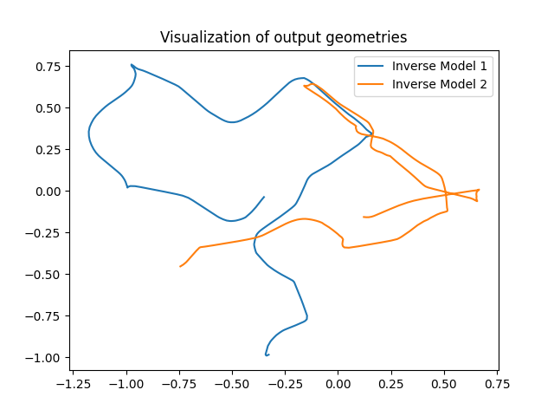

$λ$ = 0.1 Results (I/III)
Input 500 uniformly connected outputs into backwards model from [-1, 1]
Outputs are the predicted 2-D x values, plotted on the right
There appear to be two learned manifolds that overlap
Need to investigate whether these overlaps are from the same values of y

Slide 7
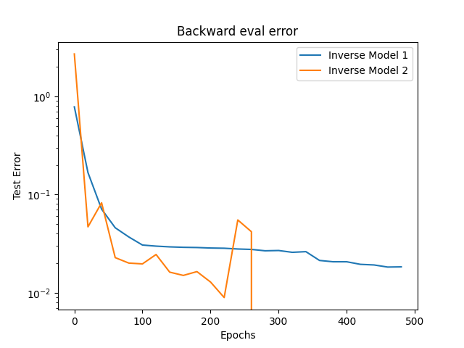
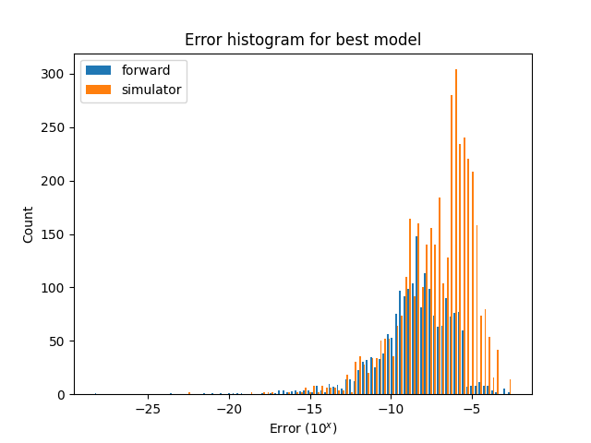
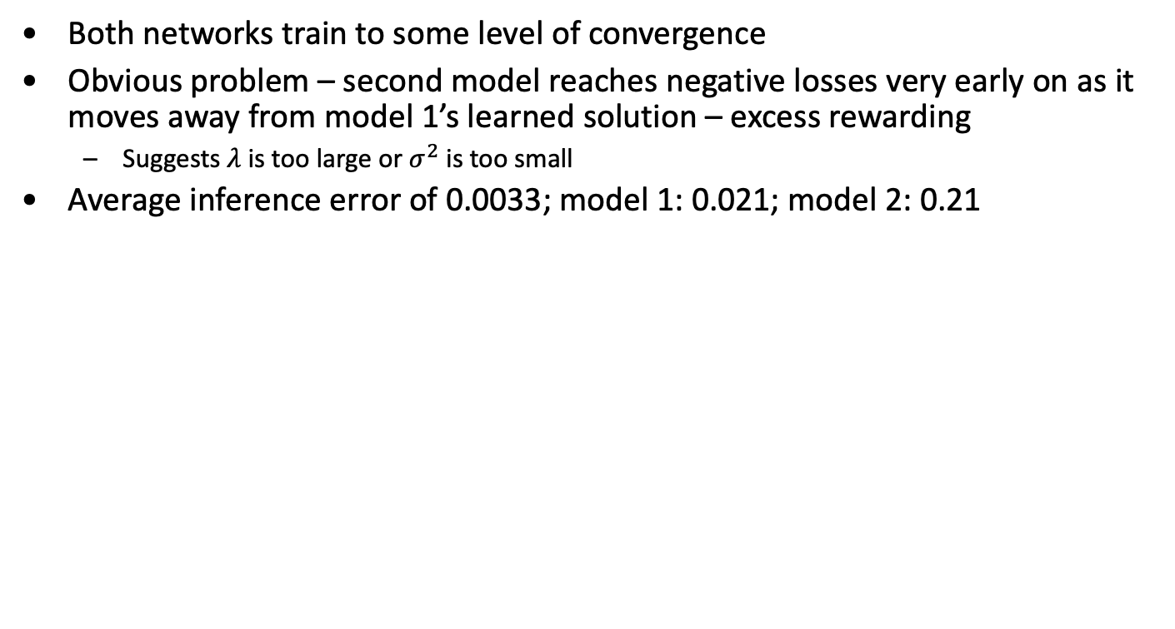

$λ$ = 0.1 Results (II/III)
Both networks train to some level of convergence
Obvious problem – second model reaches negative losses very early on as it moves away from model 1’s learned solution – excess rewarding
Suggests $λ$ is too large or $σ^{2}$ is too small
Average inference error of 0.0033; model 1: 0.021; model 2: 0.21

Slide 8
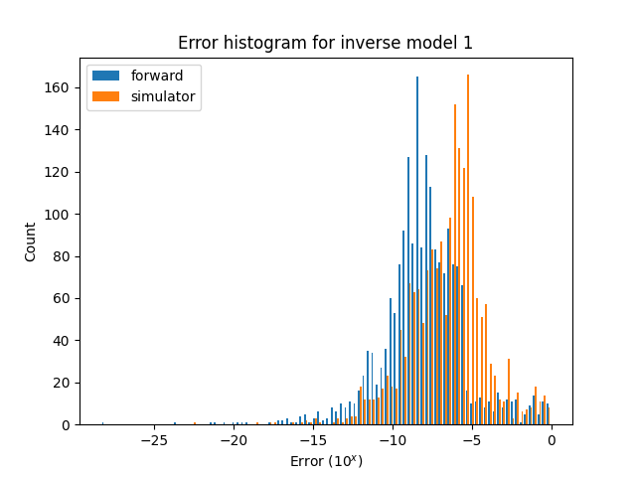
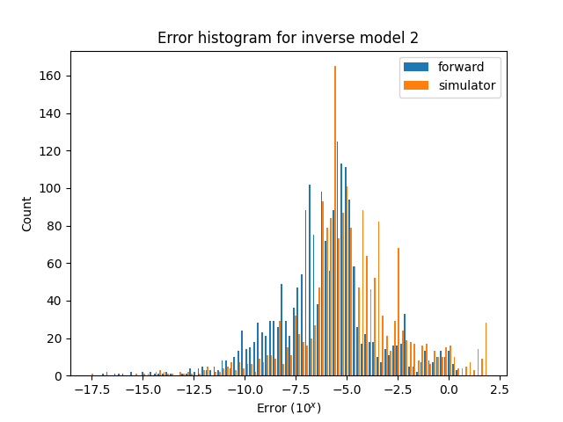

$λ$ = 0.1 Results (III/III)
Error histograms of each individual inverse model below (for reference, overall: 0.0033, model 1: 0.021; model 2: 0.21)
Looking at the histogram for model 2, it seems like the average is heavily skewed right by a handful of very poorly performing points – this explains why model 2 performed so poorly by itself but was so effective in conjunction with model 1

Slide 9
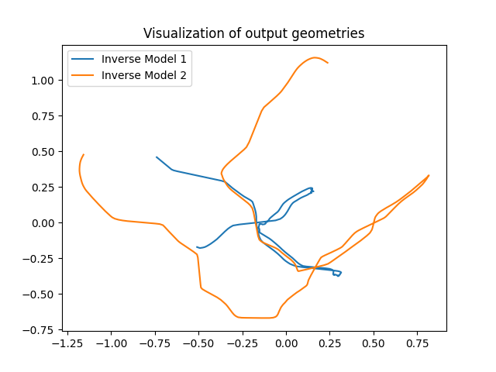
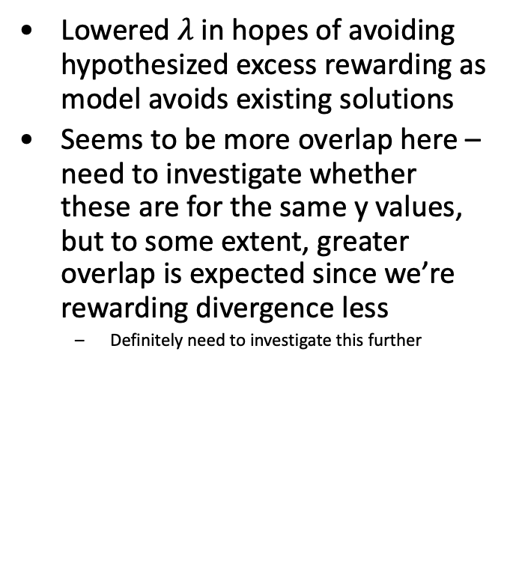

$λ$ = 0.02 Results (I/III)
Lowered $λ$ in hopes of avoiding hypothesized excess rewarding as model avoids existing solutions
Seems to be more overlap here – need to investigate whether these are for the same y values, but to some extent, greater overlap is expected since we’re rewarding divergence less
Definitely need to investigate this further

Slide 10
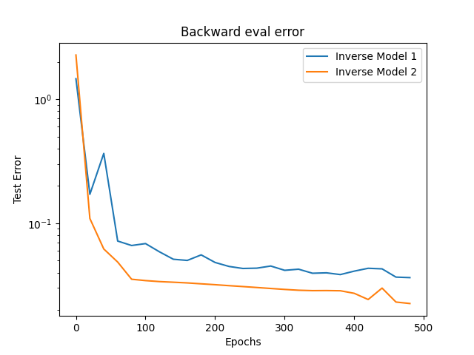
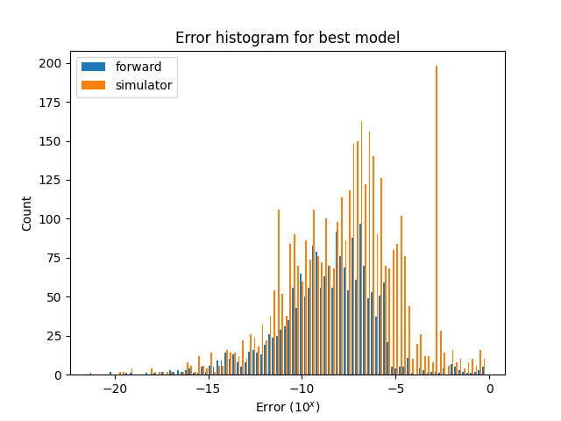
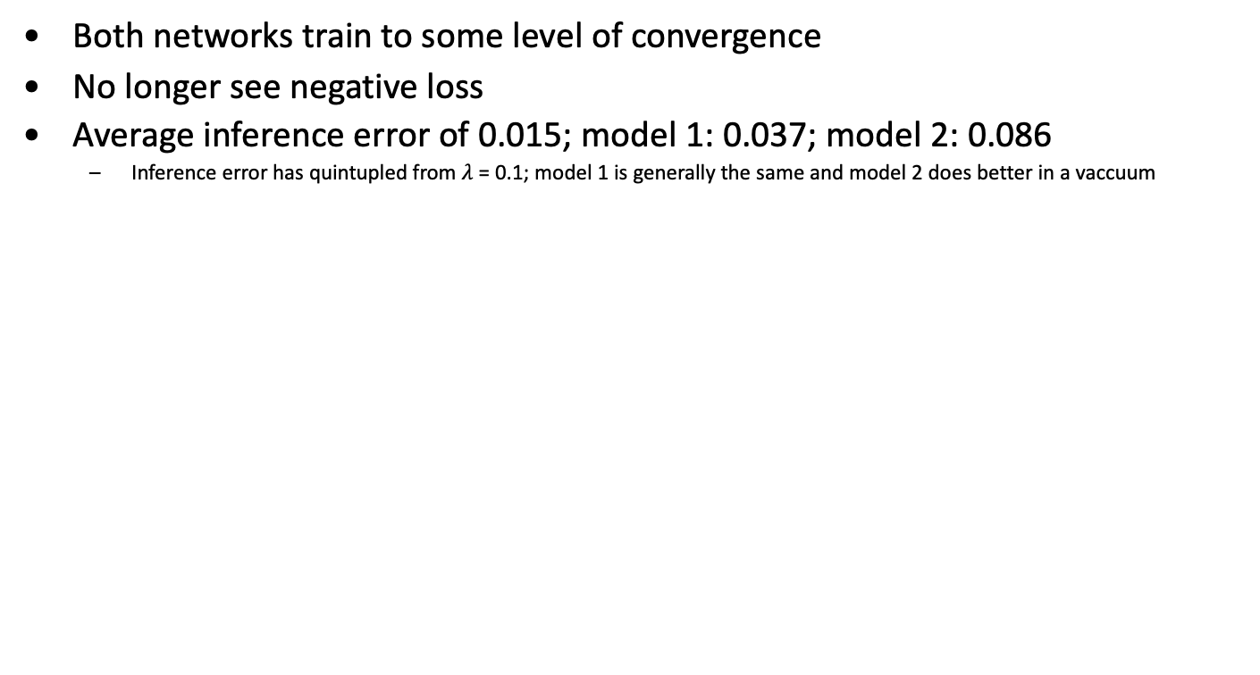

$λ$ = 0.02 Results (II/III)
Both networks train to some level of convergence
No longer see negative loss
Average inference error of 0.015; model 1: 0.037; model 2: 0.086
Inference error has quintupled from $λ$ = 0.1; model 1 is generally the same and model 2 does better in a vaccuum

Slide 11
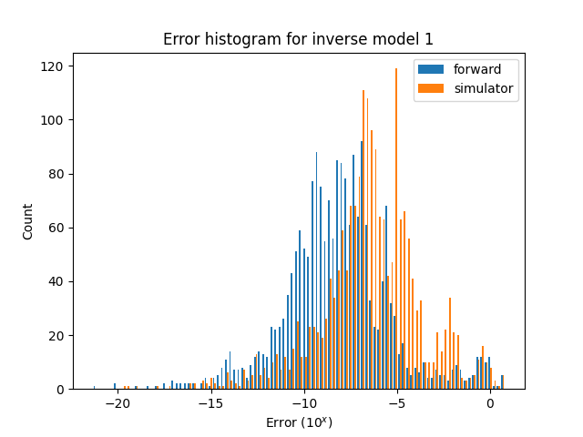
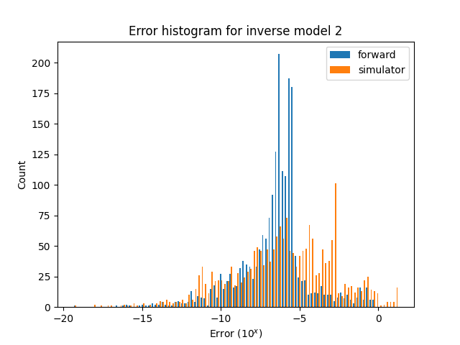

$λ$ = 0.02 Results (III/III)
Error histograms of each individual inverse model below (for reference, overall: 0.015; model 1: 0.037; model 2: 0.086)
Note the different y-scales on the graphs below
Less extremely high outliers seen for model 2 this time

Slide 12
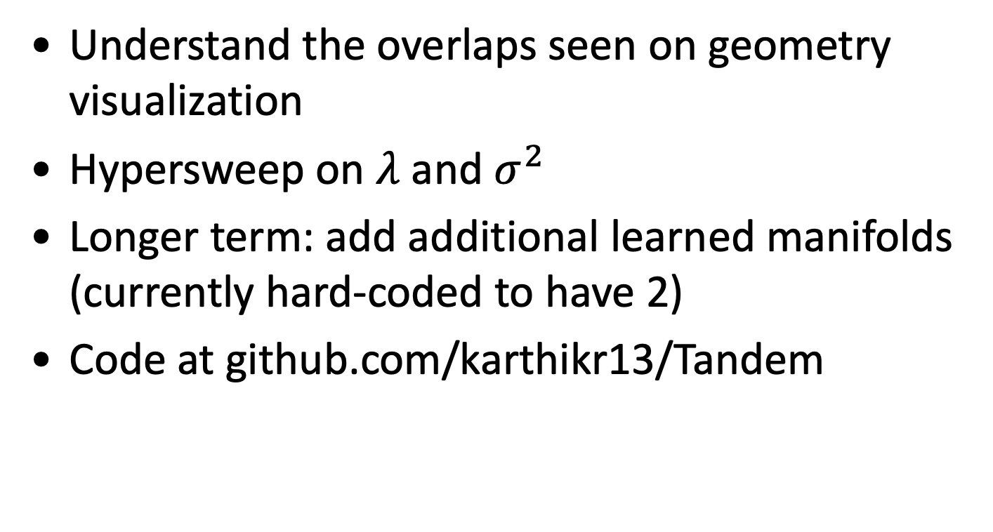
Next steps
Understand the overlaps seen on geometry visualization
Hypersweep on $λ$ and $σ^{2}$
Longer term: add additional learned manifolds (currently hard-coded to have 2)
Code at github.com/karthikr13/Tandem

